Slide 1

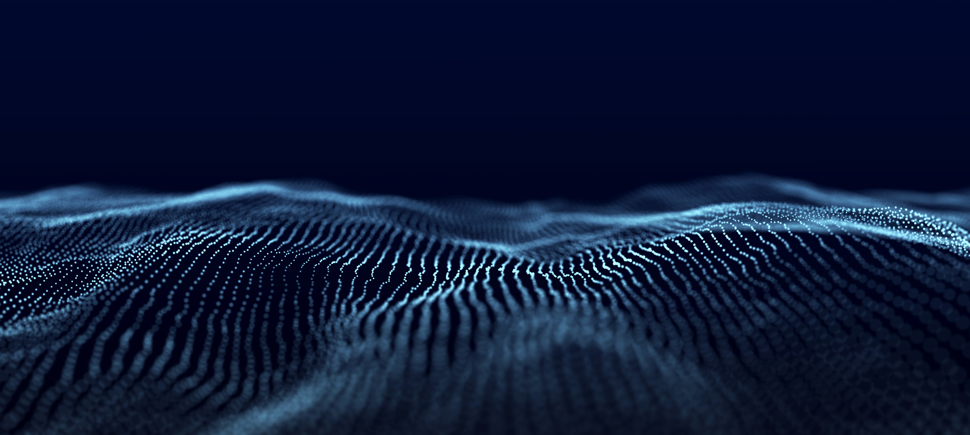
Introduction to
Deepfake detector
Presented by :-
Guided By :-
Mr. Arvind Gautam
Aqtedar Kazim (2200540130016)
Frah Adeed (2300540139003)
Asif Khan (2200540130019)

Slide 2

Introduction
DeepFake images are generated using AI models like GANs. Our
goal is to train a machine learning model that can detect whether
an image is real or fake. The ML system learns hidden
patterns, textures, and artifacts that humans cannot see.

Slide 3

OBJECTIVE
• To accurately identify and classify manipulated or AI-generated fake images using deep learning techniques. • To detect visual inconsistencies such as texture abnormalities, blending artifacts, and unnatural facial features that indicate tampering. • To train and evaluate a robust model using benchmark image datasets, ensuring high reliability under varying lighting, pose, and resolution conditions. • To develop a simple and user-friendly system that allows users to upload an image and instantly receive deepfake detection results.
OBJECTIVE
• To accurately identify and classify manipulated or AI-generated fake images using deep learning techniques.
• To detect visual inconsistencies such as texture abnormalities, blending artifacts, and unnatural facial features that indicate tampering.
• To train and evaluate a robust model using benchmark image datasets, ensuring high reliability under varying lighting, pose, and resolution conditions.
• To develop a simple and user-friendly system that allows users to upload an image and instantly receive deepfake detection results.

Slide 4
What Are DeepFake Images?
DeepFake images are produced using AI, mainly GANs, to change
faces or create new ones. They can make people look
like they are doing or saying something they never did.These images
are becoming harder to distinguish from real photos.

Slide 5
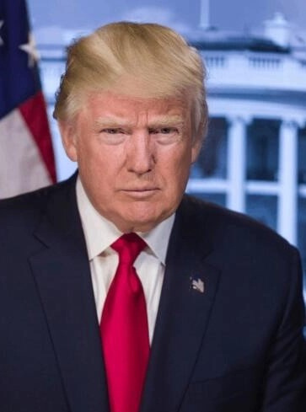

Difference Between Real and AI-Manipulated Image
Real image
Natural skin texture
Uniform lighting and clear shadows
Sharp and aligned facial details
Background looks normal
AI-Manipulated Image
Over-smooth or uneven texture
Odd lighting or reflections
Slight distortions near eyes or mouth
Background may appear warped or blurred

Slide 6
Why Detection Is
Important
Prevents misuse of someone’s identity
Stops the spread of fake or misleading content
Protects the reputation of individuals and organizations
Helps maintain trust on social media and digital platforms

Slide 7
Machine Learning Workflow
Dataset Collection (Real + Fake images)
Preprocessing (resize, normalize, crop face)
Feature Extraction (using CNN layers)
Model Training (learns Real vs Fake)
Prediction (classifies image as Genuine or Manipulated)

Slide 8
Data Used for ML Training
FaceForensics++ (Real + Fake faces)
Celeb-DF v2 (High-quality deepfake images)
DFDC Dataset (Mixed quality, real-world conditions)

Slide 9
Final Output (ML Prediction)
When an image is given to the model:
ML extracts features
Compares them with learned patterns
Outputs: Real or Fake
This helps prevent identity misuse, fraud, and misinformation.

Slide 10
Thank You
If you have any questions, feel free to ask.
Your feedback is appreciated.

